Slide 1
Machine Learning
Machine Learning Introduction to Machine Learning by Kumar Anurupam is licensed under a Creative Commons Attribution-4.0 International License.
Clustering – Density Based Clustering: DBSCAN
CS 3104 Fall 2019
Lecture Slides by Kumar Anurupam

Slide 2
Learning Objective
After the completion of today’s lesson students will be able to:
Describe the idea behind density based clustering
Explain the DBSCAN algorithm

Slide 3
Density Based Clustering
In density based clustering we partition points into dense regions separated by not-so-dense regions.
Major features:
Discover clusters of arbitrary shape
Handle noise
One scan
Need density parameters
Several interesting studies:
DBSCAN: Ester, et al. (KDD’96)
DENCLUE: Hinneburg & D. Keim (KDD’98/2006)
OPTICS: Ankerst, et al (SIGMOD’99).
CLIQUE: Agrawal, et al. (SIGMOD’98)

Slide 4
Density Based Clustering: Basic concepts
Intuition for the formalization of the basic idea
For any point in a cluster, the local point density around that point has to exceed some threshold
The set of points from one cluster is spatially connected
Local point density at a point p defined by two parameters
ε – radius for the neighborhood of point p: N_{ε} (p) := {q in data set D | dist(p, q) ≤ ε}
MinPts – minimum number of points in the given neighbourhood N(p)

Slide 5
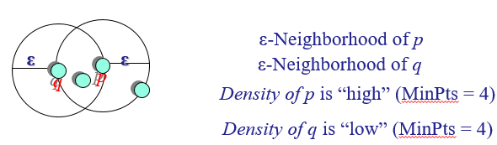
ε-Neighborhood
ε-Neighborhood – Objects within a radius of ε from an object.
“High density” - ε-Neighborhood of an object contains at least MinPts of objects.

Slide 6
Core, Border & Outlier
Outlier
Given ε and MinPts, categorize the objects into three exclusive groups.
Border
Core
A point is a core point if it has more than a specified number of points (MinPts) within Eps These are points that are at the interior of a cluster.
A border point has fewer than MinPts within Eps, but is in the neighborhood of a core point.
A noise point is any point that is not a core point nor a border point.
ε = 1unit, MinPts = 5

Slide 7
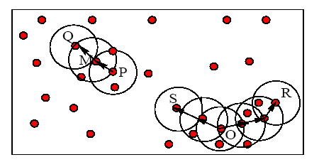
Example
M, P, O, and R are core objects since each is in an Eps neighborhood containing at least 3 points
Minpts = 3
Eps=radius of the circles

Slide 8
Density-Reachability
Directly density-reachable
An object q is directly density-reachable from object p if p is a core object and q is in p’s ε-neighborhood.
q is directly density-reachable from p
p is not directly density- reachable from q?
Density-reachability is asymmetric.
ε
ε
q
p
MinPts = 4

Slide 9
Density-reachability
Density-Reachable (directly and indirectly):
A point p is directly density-reachable from p2;
p2 is directly density-reachable from p1;
p1 is directly density-reachable from q;
p←p2←p1←q form a chain.
p
p is (indirectly) density-reachable from q
q is not density- reachable from p?
p₂
p₁
q
MinPts = 7

Slide 10
Density-Connectivity
Density-reachable is not symmetric
not good enough to describe clusters
Density-Connected
A pair of points p and q are density-connected if they are commonly density-reachable from a point o.
Density-connectivity is symmetric
p
q
o

Slide 11
Formal Description of Cluster
Given a data set D, parameter ε and threshold MinPts.
A cluster C is a subset of objects satisfying two criteria:
Connected:  p,q C: p and q are density-connected.
Maximal:  p,q: if p C and q is density-reachable from p, then q C. (avoid redundancy)
P is a core object.

Slide 12
DBSCAN: Density Based Spatial Clustering of Applications with Noise
Proposed by Ester, Kriegel, Sander, and Xu (KDD96)
Relies on a density-based notion of cluster: A cluster is defined as a maximal set of density-connected points.
Discovers clusters of arbitrary shape in spatial databases with noise

Slide 13
DBSCAN: The Algorithm
Arbitrary select a point p
Retrieve all points density-reachable from p wrt Eps and MinPts.
If p is a core point, a cluster is formed.
If p is a border point, no points are density-reachable from p and DBSCAN visits the next point of the database.
Continue the process until all of the points have been processed.

Slide 14
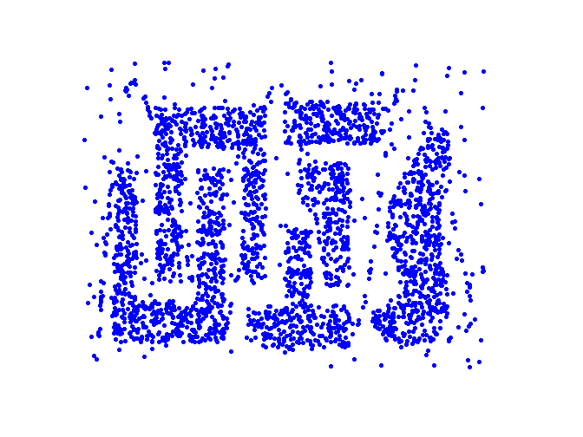
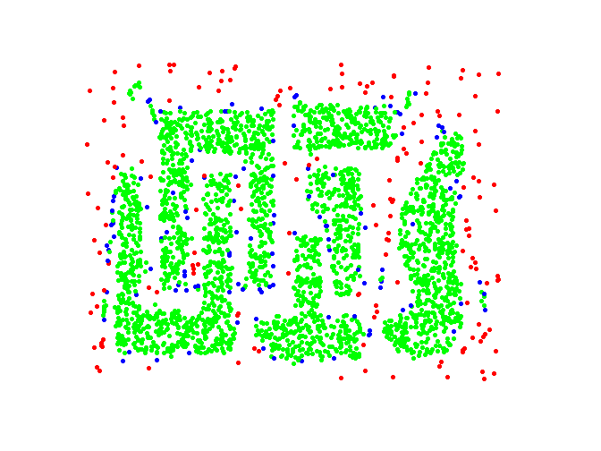
Example
Original Points
Point types: core, border and outliers
ε = 10, MinPts = 4

Slide 15
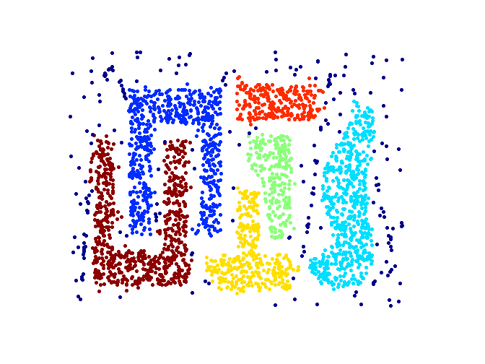
When DBSCAN Works Well
Original Points
Clusters
Resistant to Noise
Can handle clusters of different shapes and sizes

Slide 16
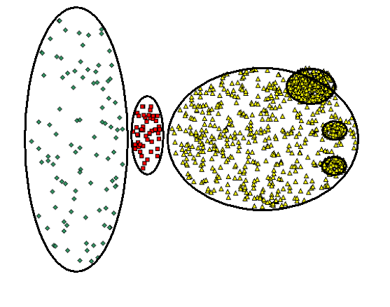
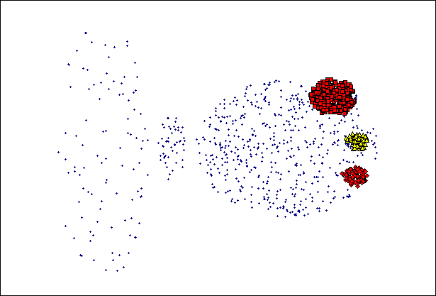
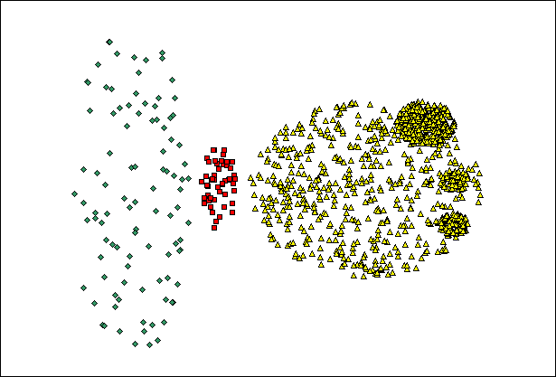
When DBSCAN Does NOT Work Well
(MinPts=4, Eps=9.92).
Original Points
Cannot handle Varying densities
sensitive to parameters
(MinPts=4, Eps=9.75)

Slide 17
References:
https://cse.buffalo.edu/~jing/cse601/fa12/materials/clustering_density.pdf
https://www.slideshare.net/ssakpi/density-based-clustering
Data Mining Concepts book by Micheline Kamber.

Slide 18
Thank you

